Slide 1

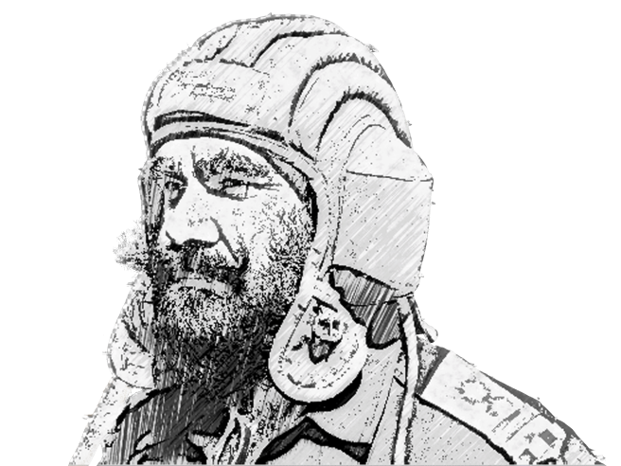
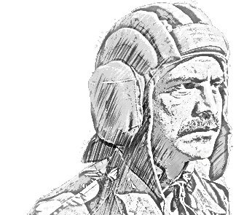
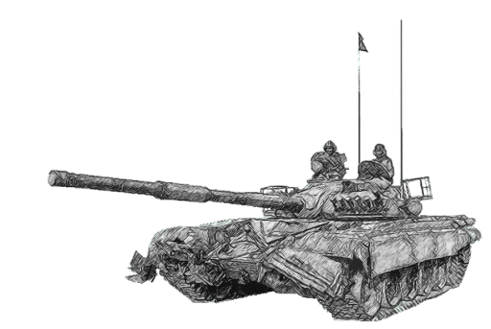
SCHOOL OF TECH TRG
ELECTRONICS WING

Slide 2
TRANSFORMERS

Slide 3
SCOPE
PART NO-I INTRODUCTION
PART NO-II CONSTRUCTION
(a) Air Core.
(b) Iron Core.
PART NO-III TYPES OF TRANSFORMER
(a) Step Up Transformer.
(b) Step Down Transformer.
(c) Even Ratio Transformer.
(d) Auto Transformer

Slide 4
SCOPE
PART NO-IV EFFECT OF AC
PART NO-V EFFECT OF DC
(a) Steady DC .
(b) Intermittent DC.
(c) Varying DC.
PART NO-VI TRANSFORMER LOSSES
(a) Copper Loss.
(b) Flux Leakage Loss.
(c) Hysteresis Loss.
(d) Saturation Loss.
(e) Eddy Current Loss.

Slide 5
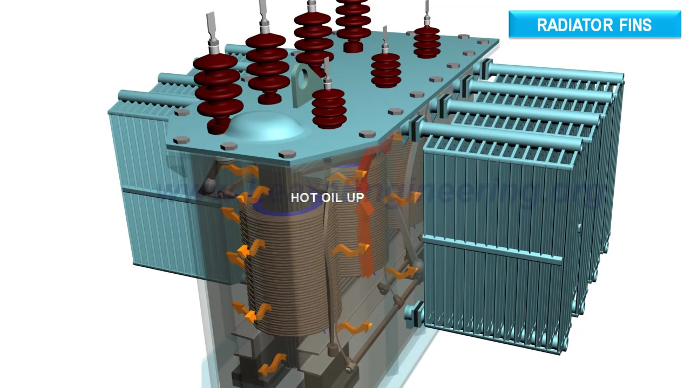

PART NO-I INTRODUCTION

Slide 6
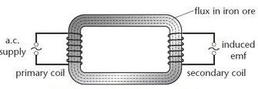
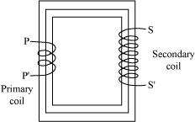
INTRO TO TRANSFORMER
Electric energy is tranfered from one cct to another cct via Magnetic Field.

Slide 7
WORKING PRINCIPLE

Slide 8
MUTUAL INDUCTION
-
+
P
S
R_{L}
+
-

Slide 9
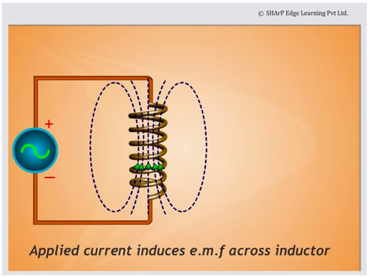

Slide 10
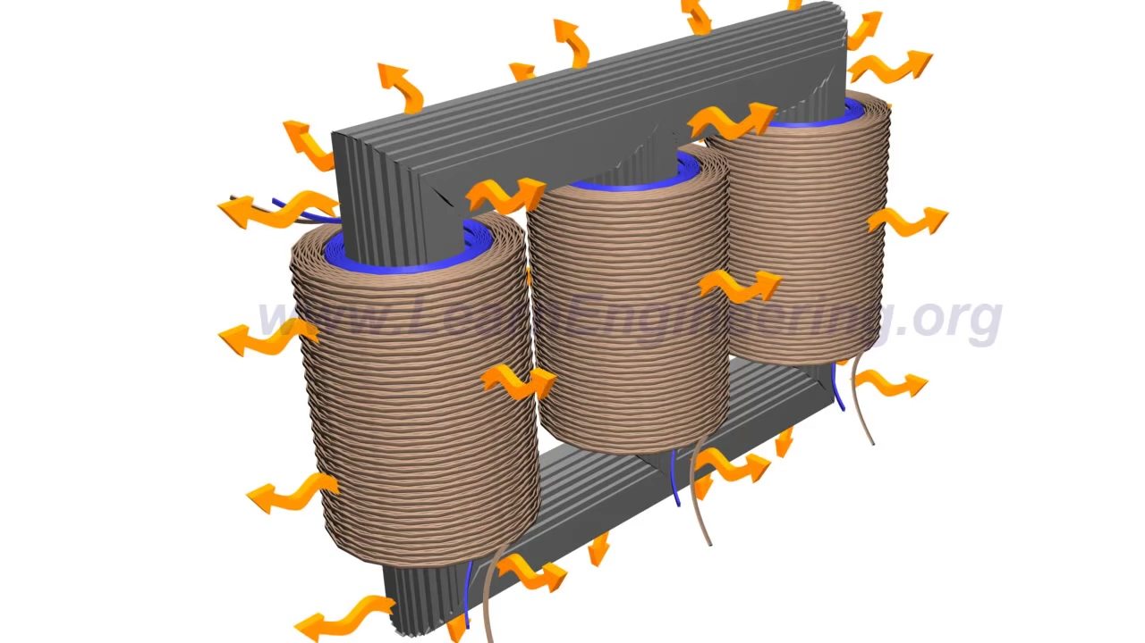
PART II- CONSTRUCTION

Slide 11
CONSTRUCTION
PRIMARY
SECONDARY
P
S
R_{L}
SOFT IRON CORE

Slide 12
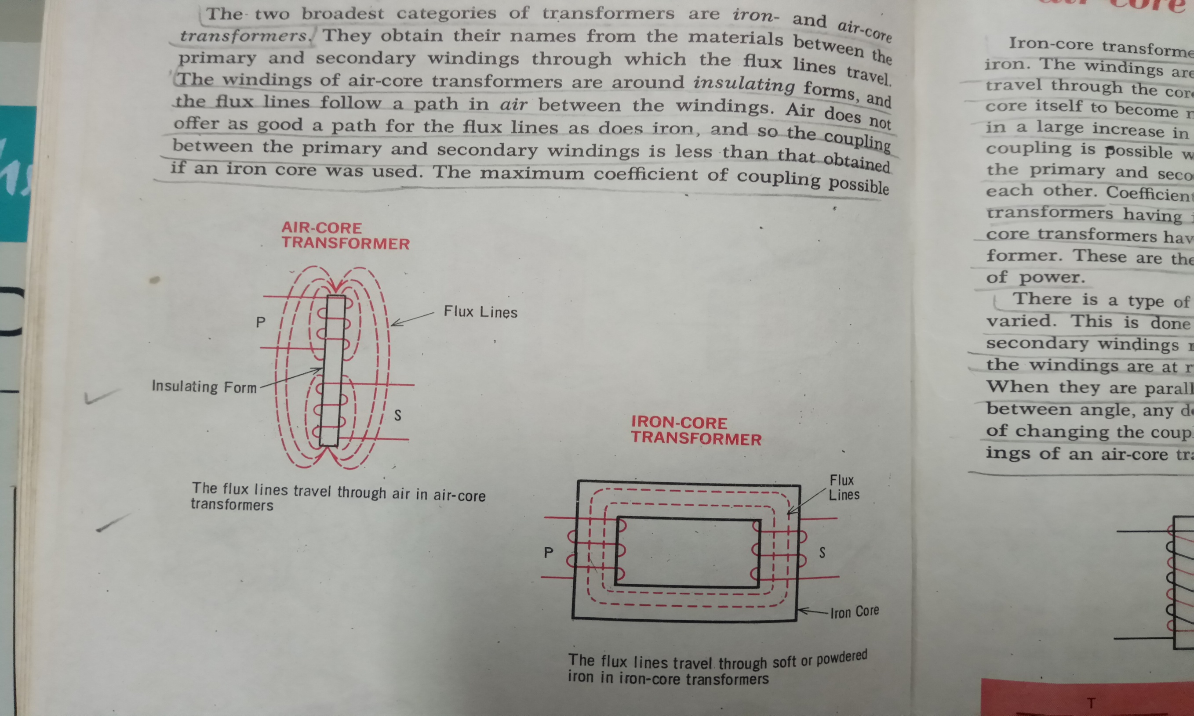
AIR CORE TRANSFORMER

Slide 13
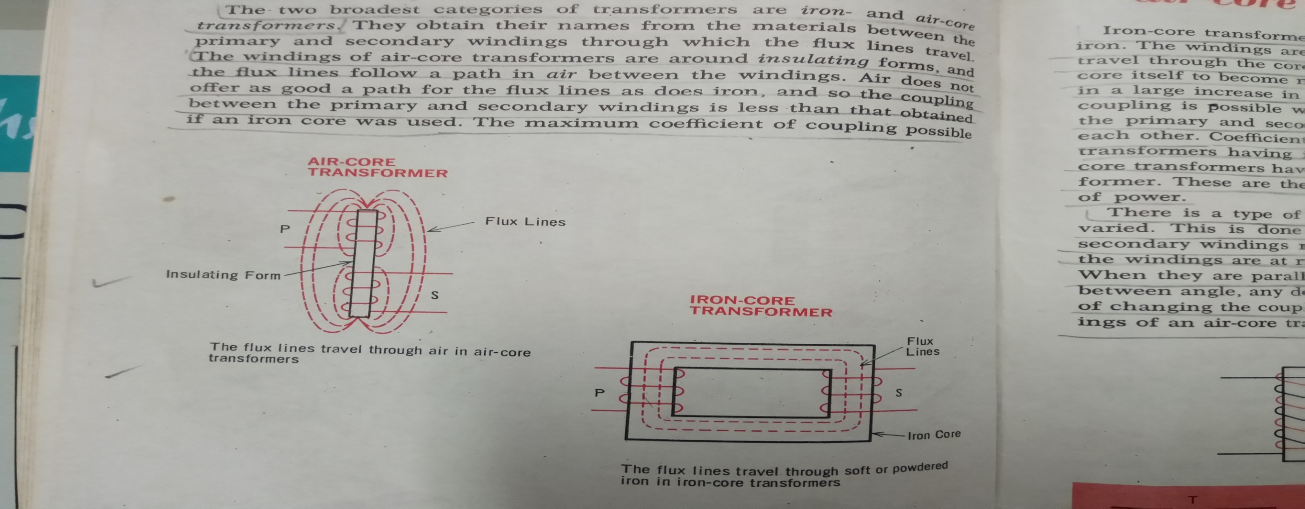
IRON CORE TRANSFORMER

Slide 14
PART III- TYPES Of TRANSFORMER

Slide 15
STEP UP TRANSFORMER
+
-
E_{P}
P
S
R_{L}
+
-
N_{P} < N_{S}
E_{P} < E_{S}

Slide 16
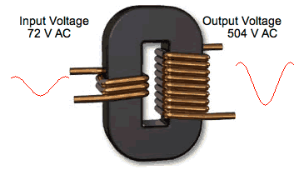
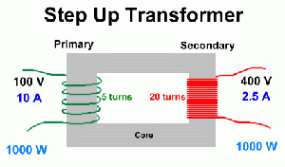
STEP UP TRANSFORMER
N_{P} < N_{S.}
E_{P} < E_{S.}
TRANFORMS LOW VOLTAGE TO HIGHER VOLTAGE.
USED IN RADIO RX, MICROPHONES, AMPLIFIERS.

Slide 17
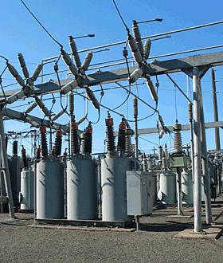
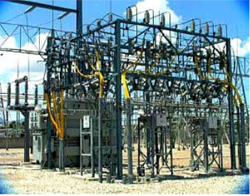
STEP UP TRANSFORMER
USED POWER STN

Slide 18
STEP DOWN TRANSFORMER
-
+
R_{L}
E_{P}
P
S
-
+
N_{P} > N_{S}
E_{P} > E_{S}

Slide 19
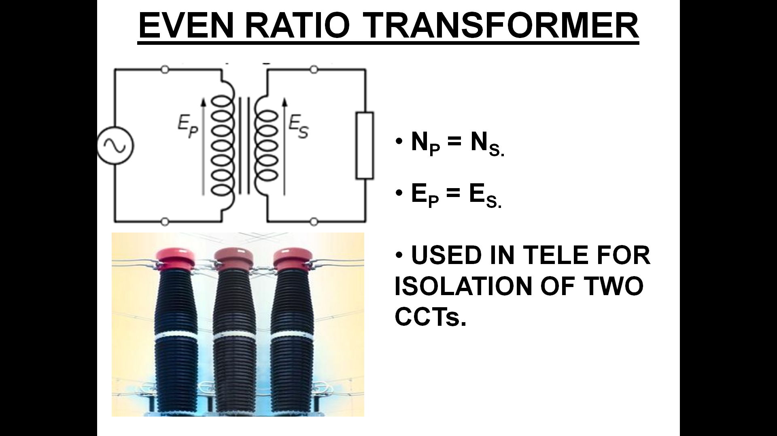
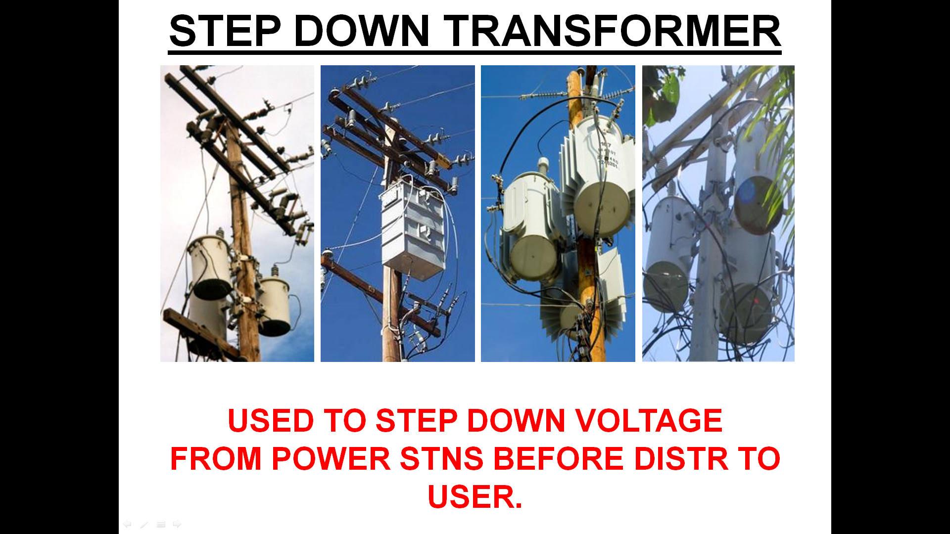
STEP DOWN TRANSFORMER
-
+
R_{L}
E_{P}
P
S
-
+

Slide 20
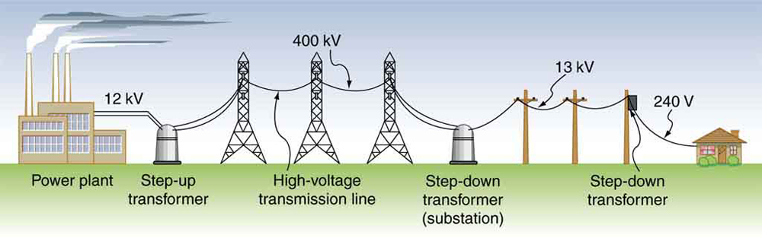
TX OF POWER : FROM STN TO HOME

Slide 21
EVEN RATIO TRANSFORMER
-
+
E_{P}
R_{L}
P
S
+
-
N_{P} = N_{S}
E_{P} = E_{S}

Slide 22
EVEN RATIO TRANSFORMER
-
+
E_{P}
R_{L}
P
S
+
-

Slide 23
AUTO TRANSFORMER
A
C
B
D

Slide 24
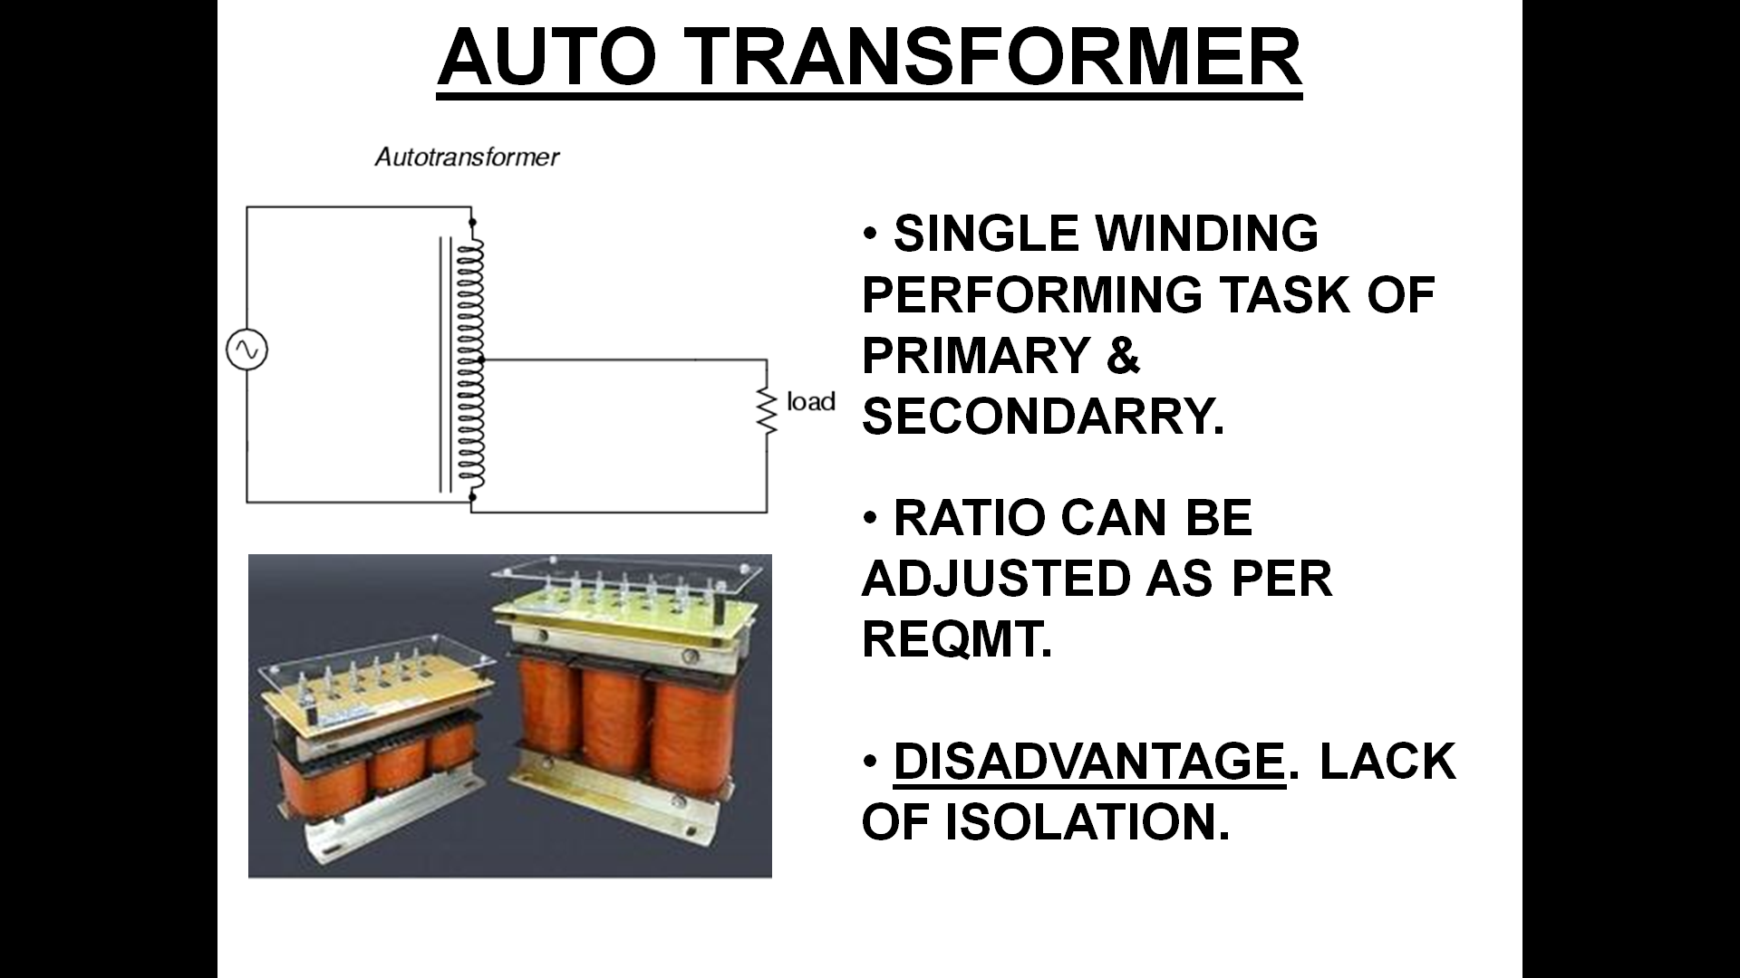
AUTO TRANSFORMER
A
C
B
B

Slide 25
PART IV- EFFECT OF AC

Slide 26
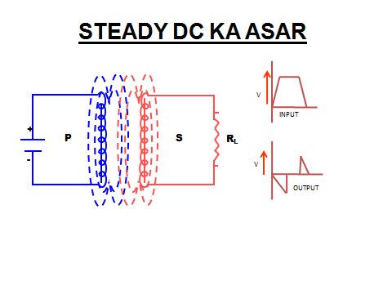
AC CURRENT

Slide 27
PART V- EFFECT OF DC

Slide 28
EFFECT OF STEADY DC
V
INPUT
+
P
S
R_{L}
-
V
OUTPUT

Slide 29
INTERMITTENT DC
V
0
V
0
INPUT IN PRIMARY
OUTPUT IN SECONDARY

Slide 30
VARYING DC
+
+
V
0
V
0
-
-
INPUT
OUTPUT

Slide 31
PART VI-TRANSFORMER LOSSES

Slide 32
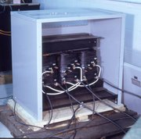
COPPER LOSS

Slide 33
FLUX LEAKAGE LOSS
WASTED FLUX
WASTED FLUX
P
USEFUL
FLUX
S

Slide 34
HYSTERESIS LOSS
+
B
C
0
D
G
FLUX DENSITY IN CORE
A
F
E
-
+
-
0
MAGNETIZING FORCE

Slide 35
SATURATION LOSS
NUMBER OF FLUX LINES IN CORE
0
PRIMARY CURRENT

Slide 36
EDDY CURRENT LOSS
UNLAMINATED CORE
LARGE EDDY
CURRENT
INSULATION
SMALL EDDY CURRENT
LAMINATED CORE

Slide 37
TRANSFORMER

Slide 38


